Slide 1
Faculty and Staff
Safely Returning to Campus

Slide 2
Content
Moving Forward with COVID-19
Returning to Work
Sanitation Procedures
Health & Safety Guidance
Social Distancing at Work
Employee Resources
Educational Resources
Adapted with permission from the UNC-Pembroke COVID-19 Plan

Slide 3
Moving Forward with COVID-19

Slide 4
Moving Forward with COVID-19
Our response to the COVID-19 Pandemic from the beginning has centered on the continued health and safety of our students, faculty, staff, and community. As we prepare to welcome our faculty, staff, and students back to campus, your health and safety will remain at the forefront.
The primary goals moving forward will be to continue providing an uncompromisingly exceptional educational experience to the students we serve, to protect the health of Robeson Community College (RCC), and to be an educational resource while navigating the short- and long-term effects of the pandemic.
To that end, RCC’s operations will follow all NC Community College System guidance, directives given by the Governor, as well as local orders and ordinances of the Robeson County Health Department. College administrators will remain in close contact with officials from all of the above-mentioned organizations weekly, and in some cases daily.
As our public health officials’ knowledge and understanding of the COVID-19 virus continues to evolve, RCC’s policies and procedures may be updated as necessary.
Notes:
https://www.nccommunitycolleges.edu/covid-19-response

Slide 5
Returning to Work

Slide 6
Returning to Work
As RCC employees return to campus, we need to ensure appropriate physical distancing, cleaning and sanitizing of work surfaces, and the availability and use of personal protective equipment (PPE). In preparation of resuming in-person instruction this fall, administrators and supervisors will determine which employees will return to campus. . ..
The information in this guide should serve as a resource for leaders to implement health and safety measures in their offices and work areas.
The guide will also provide information and resources for individual employees to practice self-care measures for their own personal safety.
For printable resources to display in office and common areas, refer to the online links or the Educational Resources Section of this document.

Slide 7
Returning to Work
In resuming operations safely, supervisors should actively work to encourage safe workspaces. Below are guidelines for consideration in returning to work and/or campus.
CONTINUING REMOTE WORK | In some cases, employees may be asked to continue teleworking at least part of the work week.
ALTERNATING SCHEDULES | Supervisors may consider scheduling staff on alternating days to limit numbers of people in any given space. When not on site, employees may be required to work remotely.
STAGGERED ARRIVAL | To avoid large groups traveling into and exiting buildings at a single point in time, supervisors may allow staggered times for employees to report to and depart from work, and during meal periods and breaks.
SYMPTOM MONITORING | Staff who have been instructed to return to the campus should closely monitor their personal health for any symptoms. Refer to the Monitoring Personal Health section of this document for specific details on how to monitor and what to do if you suspect you may have COVID-19. Employees who are not feeling well or experiencing any of the following symptoms, Should Not Report to Work. They should contact their health care provider and then their supervisor for additional instructions.
PERSONAL CARE | Employees are expected to follow personal care guidelines to stop the spread and ensure their own health and safety. These guidelines include frequent handwashing; use of antibacterial products; wearing of face coverings and, if necessary, PPE; and adherence to all social distancing recommendations. More details about personal care measures are available in the Health and Safety Guidance section of this document.
Notes:
https://www.cdc.gov/coronavirus/2019-ncov/community/office-buildings.html
https://www.cdc.gov/coronavirus/2019-ncov/if-you-are-sick/steps-when-sick.html
https://www.cdc.gov/coronavirus/2019-ncov/symptoms-testing/symptoms.html

Slide 8
Returning to Work
Contact Information
PATRICIA CLARK
Safety/Security | Building - 5 Email: pclark@robeson.edu Phone: (910) 272-3505
SALLY CARR
Human Resources | Building - 2 Email: scarr@robeson.edu Phone: (910) 272-3537

Slide 9
Sanitation Procedures

Slide 10
Sanitation Procedures
The RCC Janitorial staff has adapted a cleaning protocol to reduce the risk of cross contamination of COVID-19 by actively cleaning and disinfecting all campus buildings and offices. RCC will follow all state and federal standards established to maintain a safe and healthy work environment for everyone.
The following sanitation measures have been implemented across campus:
Touchless hand sanitizers have been placed at the entrances of all buildings and in most offices, classrooms, and common areas.
Protective shields or barriers will be installed in most high-traffic customer-service areas.
Face masks, which are required, and gloves will be made available for students, faculty and staff.
Cleaning schedules have been increased based on building usage.

Slide 11
Sanitation Procedures
Disinfect commonly touched surfaces, personal items, and work spaces twice a day.
Computer, keyboard and mouse
Doorknobs and door handles
Faucet handles and light switches
Phones Tables, desks, and countertops
Tools and other shared equipment

Slide 12
Sanitation Procedures
Protection Measures (Clean-up or Disinfection Requests)
Please contact RCC Maintenance Department for any specific building requests: (910)-272-3508 or maintenance@robeson.edu
MARY WILLIAMS
Secretary | Building - 5 Email: mwilliams@robeson.edu Phone: (910) 272-3508
KENNETH DAVIS
Facilities Manager | Building - 5 Email: kdavis@robeson.edu Phone: (910) 272-3500

Slide 13
Health & Safety Guidance

Slide 14
Health & Safety Guidance
MONITORING PERSONAL HEALTH
We encourage all faculty and staff to protect your personal health to prevent getting sick. One recommendation is to venture out for only essential errands. Pay close attention to the development of any symptoms and regularly check your temperature. If you are not feeling well or experiencing any of the following symptoms, Do Not Report to Work. Contact your health care provider and then your supervisor for additional instructions. Symptoms may appear 2-14 days after exposure to the virus.
Fever or chills
Cough
Shortness of breath or difficulty breathing
Fatigue
Muscle or body aches
Headache
New loss of taste or smell
Sore throat
Congestion or runny nose
Nausea or vomiting
Diarrhea

Slide 15
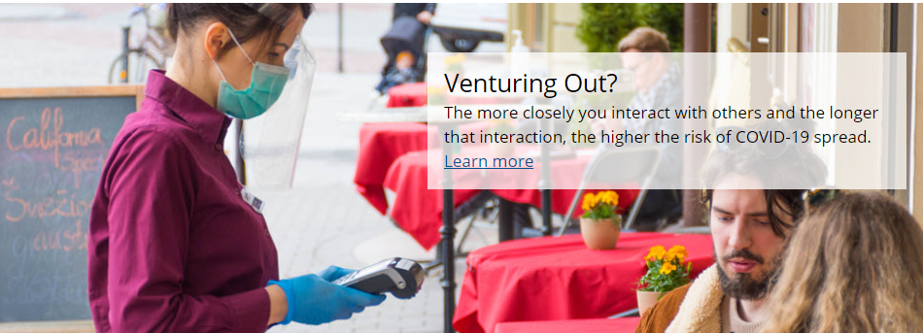
As businesses are opening, you may responsibly resume some daily activities as safely as possible. While there is no way to ensure zero risk, it is important to understand potential risks and help reduce the spread of COVID-19.
The more closely you interact with others and the longer that interaction, the higher the risk of COVID-19 spread.
If you decide to engage in public activities, continue to protect yourself by practicing everyday preventive actions.
Keep these items on hand when venturing out: a cloth face covering, tissues, and a hand sanitizer with at least 60% alcohol, if possible.
If you have traveled or been exposed to coronavirus, you should self-quarantine and notify your supervisor for further instructions.
Notes:
https://www.cdc.gov/coronavirus/2019-ncov/prevent-getting-sick/how-covid-spreads.html
https://www.cdc.gov/coronavirus/2019-ncov/if-you-are-sick/quarantine-isolation.html
https://www.cdc.gov/coronavirus/2019-ncov/prevent-getting-sick/how-covid-spreads.html

Slide 16
Health & Safety Guidance
Wearing Face Coverings
Required
WHEREAS, face coverings can decrease the spread of respiratory droplets from people, and evidence has grown, showing in numerous recent studies that the use of face coverings decreases the spread of COVID-19 within populations;
WHEREAS, to prevent the spread of COVID-19, and thereby to potentially save lives, the undersigned has determined that face coverings must now be required for workers in additional business segments; and …
WHEREAS, some people have medical or behavioral health issues, disabilities, or other reasons that mean they should be excepted from wearing a face covering, and this Executive Order puts North Carolinians on the honor system to identify if they are within one of the exceptions to face covering requirements and should not wear a mask; and …
Executive Orders
Notes:
https://governor.nc.gov/news/executive-orders

Slide 17
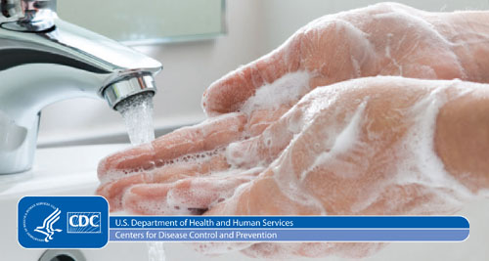
Proper Handwashing
Wear Face Coverings
Wash your hands often with soap and water for at least 20 seconds, especially after you have been in a public place or after blowing your nose, coughing, or sneezing.
If soap and water are not readily available, use a hand sanitizer that contains more than 60% ethanol or 70% isopropanol. Cover all surfaces of your hands and rub them together until they feel dry.
Avoid touching your eyes, nose, and mouth with unwashed hands.
Face masks or coverings are required for all faculty, staff, students, and visitors on campus.
Even if you do not have any symptoms, you could spread COVID-19 to others.
COVID-19 Stations with masks, hand sanitizer, and information will be available in designated areas.
Carry a face covering at all times, in case you encounter an unforeseen situation where at least six feet of physical distance cannot be maintained. Such situations are likely to occur in hallways, stairwells, elevators, restrooms, etc.
Notes:
https://www.cdc.gov/handwashing/videos.html
https://www.cdc.gov/handwashing/when-how-handwashing.html
https://www.cdc.gov/coronavirus/2019-ncov/hcp/hand-hygiene.html
https://www.cdc.gov/coronavirus/2019-ncov/prevent-getting-sick/diy-cloth-face-coverings.html

Slide 18
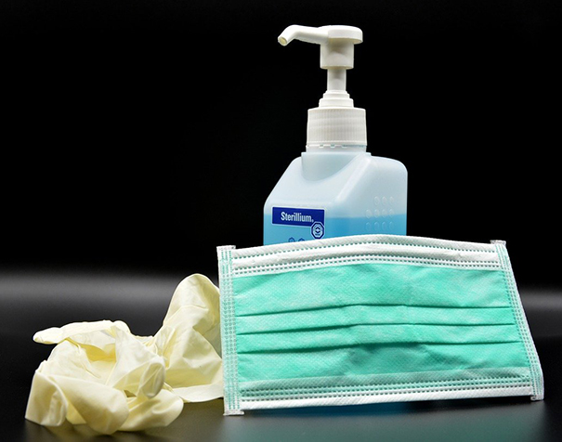
Health & Safety Guidance
PRACTICE GOOD PERSONAL HYGIENE
Always cover your mouth and nose with a tissue when you cough or sneeze, or use the inside of your elbow.
Discard used tissues in the trash and immediately wash your hands with soap and water for at least 20 seconds or use hand sanitizer.
Avoid or minimize touching your face, eyes, nose and mouth.
Avoid touching surfaces immediately after other individuals without wearing gloves or using a protective barrier.
Avoid sharing electronic devices that have not been cleaned between uses.
Wash hands thoroughly after trips to the restroom. Use paper towel or tissue to open door handles in common spaces, or utilize automatic door buttons whenever available.
Politely decline hugs, handshakes, high fives, or other common gestures involving contact with other individuals.
WEARING OF GLOVES AND PPE
Gloves | Health care workers and others in high-risk areas should use gloves as part of PPE, but according to the CDC, gloves are not necessary for general use and do not replace good hand hygiene. Washing your hands often is considered the best practice.
Goggles/face shields | Faculty and staff do not need to wear goggles or face shields as part of general activity on campus, unless specific PPE is required for occupation. Good hand hygiene and avoiding touching your face are generally sufficient for non-health care environments.
Gowns/suits | Health care workers generally wear protective gowns and/or body coverings. These are not necessary for faculty and staff in non-health care settings, according to the CDC Guidelines for Colleges.
Notes:
https://www.cdc.gov/coronavirus/2019-ncov/hcp/hand-hygiene.html
https://www.cdc.gov/coronavirus/2019-ncov/prevent-getting-sick/gloves.html
https://www.cdc.gov/coronavirus/2019-ncov/community/colleges-universities/index.html

Slide 20
Health & Safety Guidance
Contact Information
ERIC FREEMAN
Emergency Services |Building - 17 Email: efreeman@robeson.edu Phone: (910) 272-3316
EVA MEEKINS
Nursing | Building - 17 Email: emeekins@robeson.edu Phone: (910) 272-3398

Slide 21
Social Distancing at Work

Slide 22
Social Distancing at Work
Social Distancing is the set of intentional actions performed to decrease density and alter traffic patterns within worksites with the goal of maintaining at least six feet of space between persons present.
Notes:
https://www.cdc.gov/coronavirus/2019-ncov/prevent-getting-sick/social-distancing.html
https://covid19.ncdhhs.gov/materials-resources/know-your-ws-wear-wait-wash

Slide 23
Social Distancing at Work
Employees should wait to use common areas until they can maintain a safe distance, at least six feet away, from other individuals.
WORKING IN AN INDIVIDUAL OFFICE | If you work in an office, no more than one person should be in the same room unless the required 6-feet of distancing can be consistently maintained. If more than one person is in a room, masks or face coverings must be worn at all times. A mask or face covering is not required if you are working alone in a confined office space. This does not include partitioned work areas in a large open environment.
OPEN WORKSPACES | If you work in an open environment, be sure to maintain at least 6 feet of distance from co-workers. For example, have at least one workspace separating you from another co-worker. It is required you wear a mask or face covering while in a shared work space or room. Departments should assess open work environments and meeting rooms to institute measures to physically separate and increase distance between employees, other co-workers and any individual in the space. These may include visual cues on floors and directional signage for large open workspaces with multiple through-ways to increase distance between individuals.

Slide 24
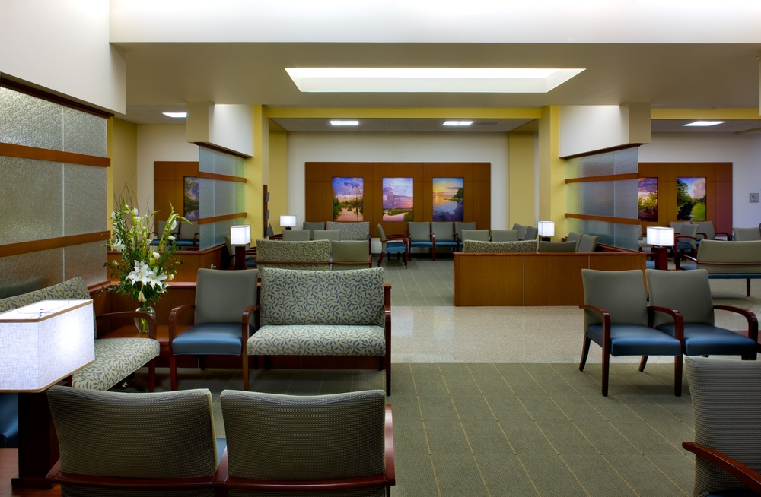
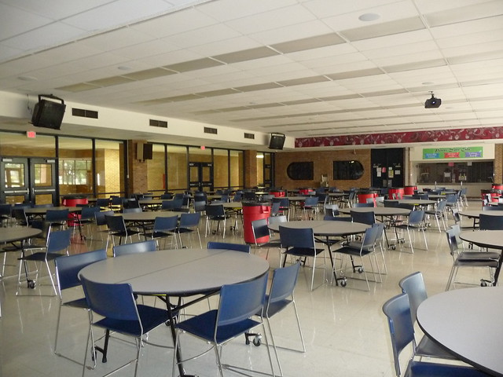
Social Distancing at Work
Employees should wait to use common areas until they can maintain a safe distance, at least six feet away, from other individuals.
RECEIVING/RECEPTION AREAS | Masks or face coverings are required to be worn by any staff in a reception or receiving area.
DINING ON CAMPUS | Before and after eating, you should wash your hands thoroughly to reduce the spread or transmission of the virus. If eating in common areas, individuals should sit 6 feet apart. You should wear your mask or face covering until you are ready to eat and then replace it immediately afterward. Staff are encouraged to take food back to their office area or eat outside. If you are eating in your work environment (break room, office, etc.), maintain 6 feet of distance between you and others. Departments should remove or rearrange chairs and tables or add visual cue marks in employee break rooms to support social distancing practices between employees. Wipe and disinfect all surfaces such as table, refrigerator handle, coffee machine, etc. after using common areas.

Slide 25
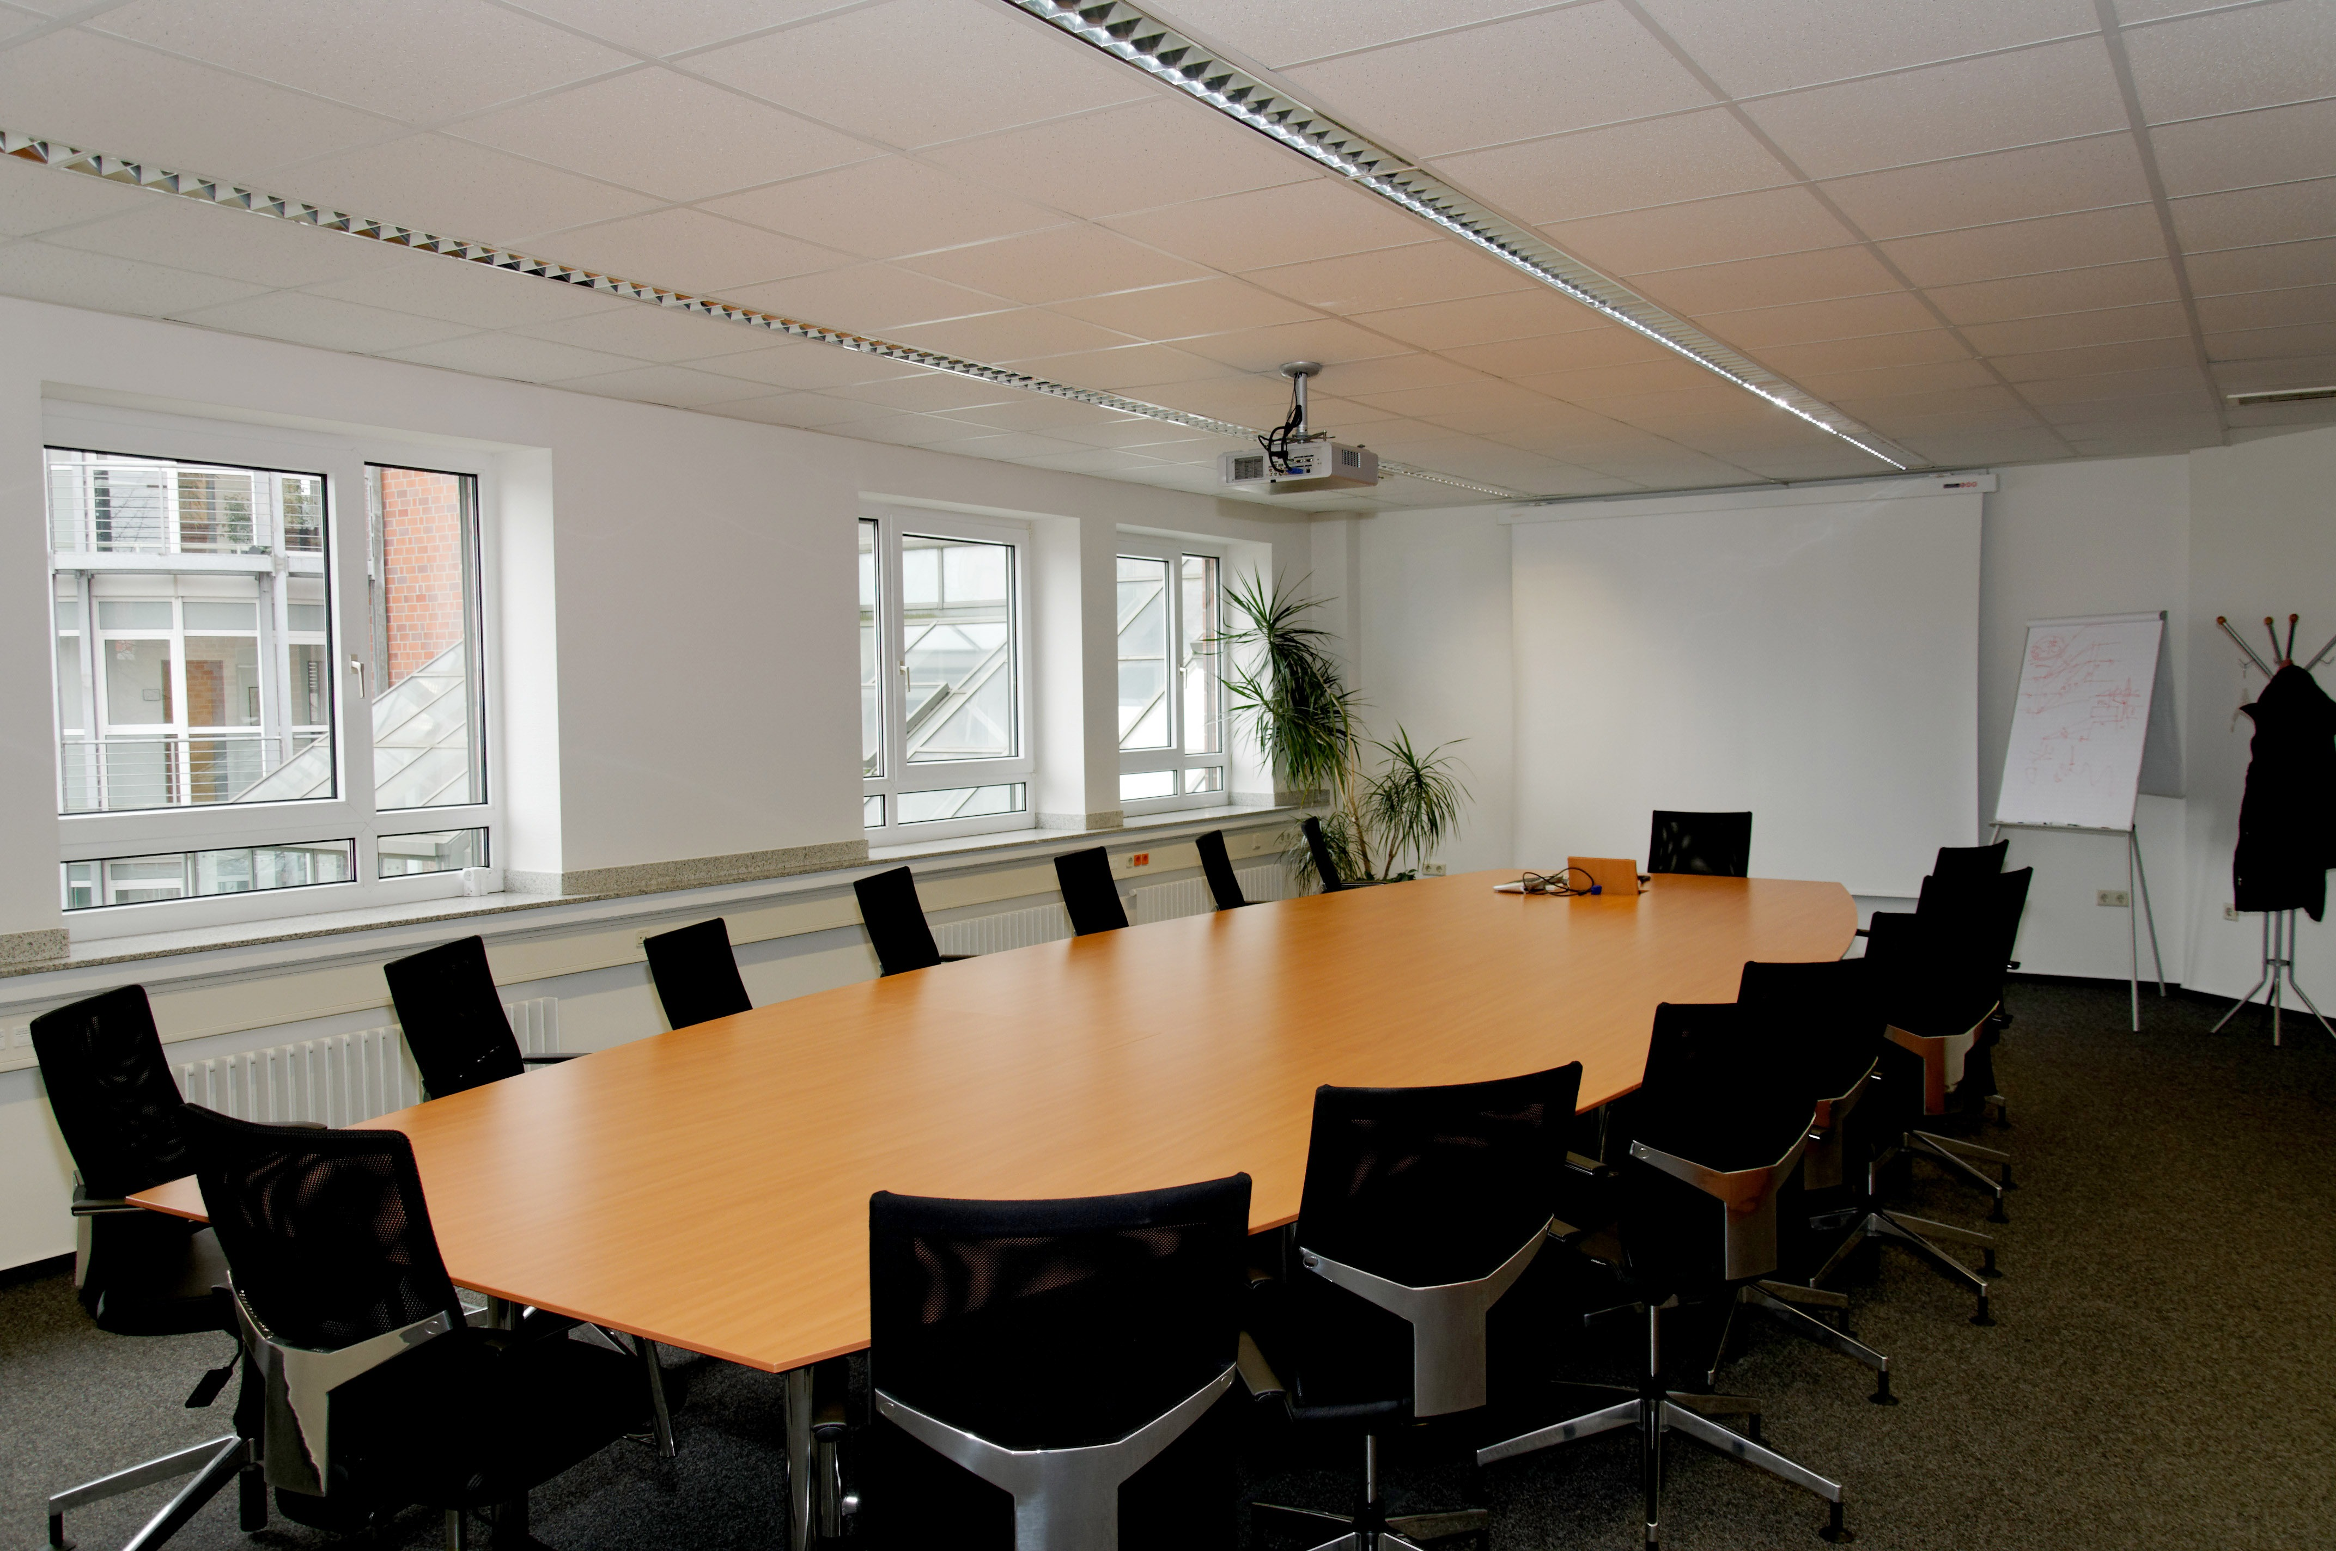
Social Distancing at Work
Employees should wait to use common areas until they can maintain a safe distance, at least six feet away, from other individuals.
USING ELEVATORS AND STAIRWELLS | No more than one person should enter an elevator at a time. Use of the stairs is encouraged whenever possible. If you are using the elevator, wear your mask or face covering and avoid touching the elevator buttons with exposed fingers, if possible. When using the stairs, please be courteous and respectful of others in front, behind, or passing in the opposite direction. Step to the side to offer the appropriate 6 feet distance between individuals.
MEETINGS/CONFERENCE ROOMS | Convening in groups increases the risk of viral transmission. Where feasible, meetings should be held in whole or part using virtual conferencing services like Microsoft Teams. In-person meetings are limited to the restrictions of local, state, and federal orders and should not exceed 50% of a room’s capacity, assuming individuals can still maintain 6 feet of separation for social distancing requirements. Departments should remove or rearrange chairs and tables or add visual cue marks in meeting rooms to support social distancing practices. All attendees must wear a mask or face covering while in conference and meeting rooms.

Slide 26
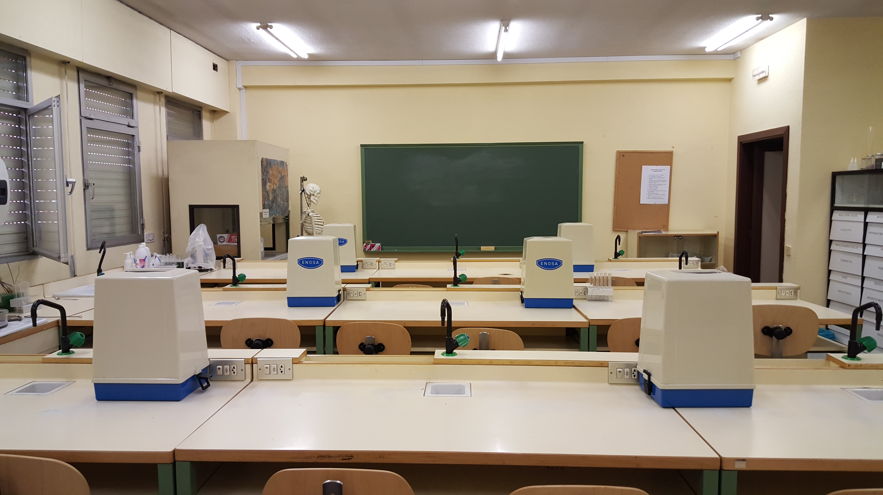
Social Distancing at Work
Employees should wait to use common areas until they can maintain a safe distance, at least six feet away, from other individuals.
Classrooms/Labs| Reduce capacity i.e. remove tables, desks, chairs to allow for social distancing given the square footage. Remove whiteboard pens and erasers and encourage students or attendees to bring and manage their own.

Slide 27
Social Distancing at Work
Employees should wait to use common areas until they can maintain a safe distance, at least six feet away, from other individuals.
ENTERING AND EXITING BUILDINGS | When entering or exiting buildings, please be courteous and respectful of others in front, behind, or passing in the opposite direction. Step to the side to offer the appropriate 6-feet of distance between individuals.
USING RESTROOMS | Use of restrooms should be limited based on size to ensure at least 6-feet of distance between individuals. Wash your hands thoroughly afterward to reduce the potential transmission of the virus.

Slide 28
Social Distancing at Work
Contact Information
PATRICIA CLARK
Safety/Security | Building - 5 Email: pclark@robeson.edu Phone: (910) 272-3505
SALLY CARR
Human Resources | Building - 2 Email: scarr@robeson.edu Phone: (910) 272-3537

Slide 29
Employee Resources

Slide 30
Employee Resources
EMPLOYEE ASSISTANCE PROGRAM
This Employee Assistance Program (EAP) offers services for personal issues, planning for life events, or simply managing day-to-day tasks that may affect your work life, health, and family. McLaughlin Young Group provides confidential services at no cost to you as an RCC employee and your immediate family. Your McLaughlin Young Group program offers someone to talk to and resources to consult whenever and wherever you need them. For more information, please visit mygroup.com/portal/employee
WORK & LEAVE PROVISIONS
Guidance and information on work and leave provisions offered by the Department of Labor can be found at https://www.dol.gov/agencies/whd/pandemic/ffcra-employer-paid-leave
RESOURCE LINKS AND INFORMATION
RCC has established a COVID-19 response web section at https://www.robeson.edu/coronavirus-info/

Slide 31
Federal Emergency Leave Provisions
The Families First Coronavirus Response Act (FFCRA or Act) requires certain employers to provide their employees with paid sick leave and expanded family and medical leave for specified reasons related to COVID-19.
These provisions will apply from April 1, 2020, through December 31, 2020. Please click the link below for more information.
For More Information
Families First Coronavirus Response Act | Questions and Answers
If one of these leave provisions apply to you, please contact Human Resources at 910-272-3537 or scarr@robeson.edu.

Slide 32
NC Community College System Resources
The 58 colleges of the NC Community College System continue their mission to provide high-quality, accessible educational opportunities for hundreds of thousands of people across the state.
During the COVID-19 pandemic, the colleges have transitioned to online and alternate delivery of education for the near future. Face-to-face instruction has been paused for all classes except certain public safety and public health programs that are critical to North Carolina's current emergency needs.
Here, you will find the latest information about the colleges' response to COVID-19, as well as answers to frequently asked questions for faculty, students and colleges. Students will find resources for online learning, free internet services and other support.
https://www.nccommunitycolleges.edu/covid-19-response
Notes:
CDC Resuming Business Toolkit
https://www.cdc.gov/coronavirus/2019-ncov/community/resuming-business-toolkit.html
https://www.cdc.gov/coronavirus/2019-ncov/downloads/community/Resuming-Business-Toolkit.pdf

Slide 33
Employee Resources
Contact Information
SALLY CARR
Human Resources | Building - 2 Email: scarr@robeson.edu Phone: (910) 272-3537

Slide 34
Educational Resources

Slide 35
Educational Resources
COVID-19 Videos (CDC.gov)
I Had COVID-19, But No Symptoms. When Can I Be with Others?
Social Distancing
I Think or Know I had COVID-19, and I had Symptoms. When Can I Be With Others?
Cloth Face Covering Do’s and Don’ts
How to Clean and Disinfect Your Home if Someone has COVID-19
COVID-19 Stop the Spread of Germs
Notes:
https://www.youtube.com/watch?v=tpsOw7kkJSY
https://www.youtube.com/watch?v=2qw06OVHsRE
https://www.youtube.com/watch?v=SYEk4b6uKcM
https://www.youtube.com/watch?v=Xdd2M40Leb0
https://www.youtube.com/watch?v=VciAY7up1Fs
https://www.youtube.com/watch?v=W-zhhSQDD1U

Slide 36
Educational Resources
For more information about how you can protect yourself and others from COVID-19, review online print resources or visit the following.
American College Health Association (ACHA)
Centers for Disease Control and Prevention (CDC)
NC Department of Health and Human Services
Occupational Safety and Health Administration

Slide 37
Educational Resources
Contact Information
PATRICIA CLARK
Safety/Security | Building - 5 Email: pclark@robeson.edu Phone: (910) 272-3505

Slide 38
COVID-19
Frequently Asked Questions
Basics
Why is the disease being called coronavirus disease 2019 or COVID-19?
Cleaning and Disinfection
What is the difference between cleaning and disinfecting?
Prevention
How can I protect myself?
Am I at risk for COVID-19 from mail, packages etc.?
Should I use soap and water or hand sanitizer?
Spread
How does the virus spread?
Travel
What if I recently traveled and get sick?
For RCC Faculty and Staff
What should I do if I get sick or someone in my house gets sick?
What should I do if I have had close contact with someone who has COVID-19?
What if I have traveled or been exposed to coronavirus, should I self-quarantine and notify my supervisor for further instructions?
Do Not Report to Work.
Contact your health care provider and then your supervisor for additional instructions
Refer to the Employee Resources section of this document.

Slide 39
RCC Healthy Pledge
All faculty, staff and students will acknowledge the following
community commitment prior to the start of the semester.
I acknowledge and pledge to abide by the following community standards because I am committed to ensuring the health and safety of our campus community:
I will properly wear a face covering in all in-person classes and in all campus facilities and locations.
I will stand, sit, and wait a minimum of 6 feet from other individuals.
I will not get into an elevator with more than 1 other individual and we will both wear masks.
I will abide by all posted health and safety guidelines throughout campus.
I will actively self-monitor my own personal health and remain home when I am sick.
I understand these health standards are in place to not only protect my own personal health but that of my peers, faculty and staff I interact with while on campus.

Slide 40
Thank You, RCC
We're in this together!

